Slide 1
SYNOPSIS PRESENTATION ON Design and Implementation of Low-Power 32-bit RISC-V Processor for IOT and Biomedical Applications
GUIDE : Dr. NAPOLEAN
ASSOCIATE PROFESSOR
ECE DEPT, AIET.
AMOGH KAMATH | 4AL23EC006
ARJUN P SHETTY | 4AL23EC012
DARSHAN KUMAR R | 4AL23EC020
DEEKSHA SU | 4AL23EC022

Slide 2
INTRODUCTION
Modern biomedical devices such as wearable monitors and implantable sensors require efficient processors to continuously process physiological signals like ECG and EEG.
Since biomedical devices often run on small batteries, processors must be designed to consume minimal power while maintaining reliable performance.
RISC-V is an open-source and customizable processor architecture that enables the development of flexible and energy-efficient embedded systems.
This project focuses on designing a low-power, resource-efficient RISC-V processor optimized for biomedical application in portable healthcare devices.

Slide 3
PROBLEM STATEMENT
Conventional processors like arm cortex m series often consume higher power [ranges from 10mW to 500mW ] and require larger hardware resources, making them inefficient for compact biomedical systems.
There is a need for a customizable[user friendly, flexible] and energy-efficient processor architecture that can handle biomedical signal processing with minimal power consumption
Low-Power Resource-Efficient RISC-V Processor for Biomedical Applications [approximately power consumption is from 10mW to 50mW]

Slide 4
OBJECTIVES
Design a 32-bit low-power RISC-V processor for biomedical and IoT applications.
Implement using Cadence, and verify through simulation.
Analyze power, speed, and hardware utilization
Optimize the architecture to reduce power consumption and improve efficiency.

Slide 5
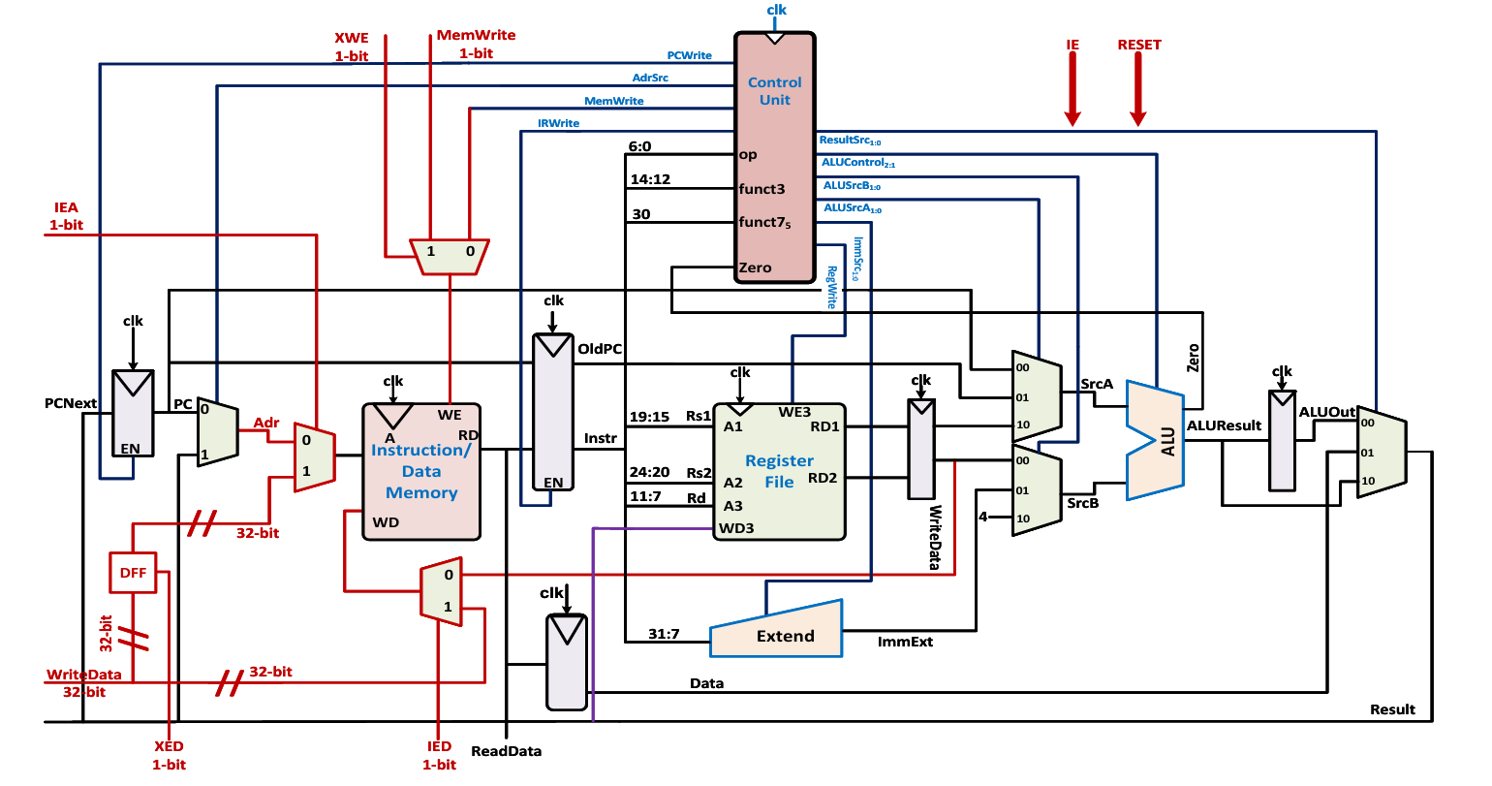
EXISTING SYSTEM

Slide 6
EXISTING SYSTEM
Biomedical devices use traditional microcontrollers or proprietary processor architectures.
Higher power consumption reduces battery life of wearable and implantable devices.
Fixed architectures limit customization for biomedical applications.
Reduced efficiency and flexibility in biomedical device design.

Slide 7
LITERATURE REVIEW
Ref. No | Paper (Short Name) | Power | Area / Resources | Efficiency
[1] | Bio-RV: Low-Power Resource-Efficient RISC-V Processor | 15 mW | 697,039 µm² (ASIC), 708 LUTs, 235 FFs | 17.18 pJ/cycle
[2] | FPGA Based 32-bit RISC-V Processor | N/A | Compact FPGA implementation with cache (4 KB I-cache, 1 KB D-cache) | 1.35 CoreMark/MHz, 0.505 DMIPS/MHz
[3] | Low-Power IoT RISC-V Processor with Hybrid Encryption | N/A | N/A | Improved energy efficiency for secure IoT processing

Slide 8
LITERATURE REVIEW – “Cont’d”
[4] | RTL to GDSII RISC-V Processor Implementation | N/A | Full ASIC flow (RTL → GDSII) | N/A
[5] | Low-Power RISC-V Core for Edge Devices | N/A | Energy-constrained lightweight core | High energy efficiency for edge systems
[6] | Multicore RISC-V with Shared Lightweight FPU | Reduced power architecture | Multicore design with shared FPU | Improved area & energy efficiency for IoT nodes

Slide 9
PROPOSED SYSTEM
Design a low-power and resource-efficient processor for biomedical applications.
Use RISC-V architecture for flexibility and customization.
Optimize the processor to reduce power consumption and hardware area.
Enable efficient processing of biomedical signals in wearable healthcare devices.

Slide 10
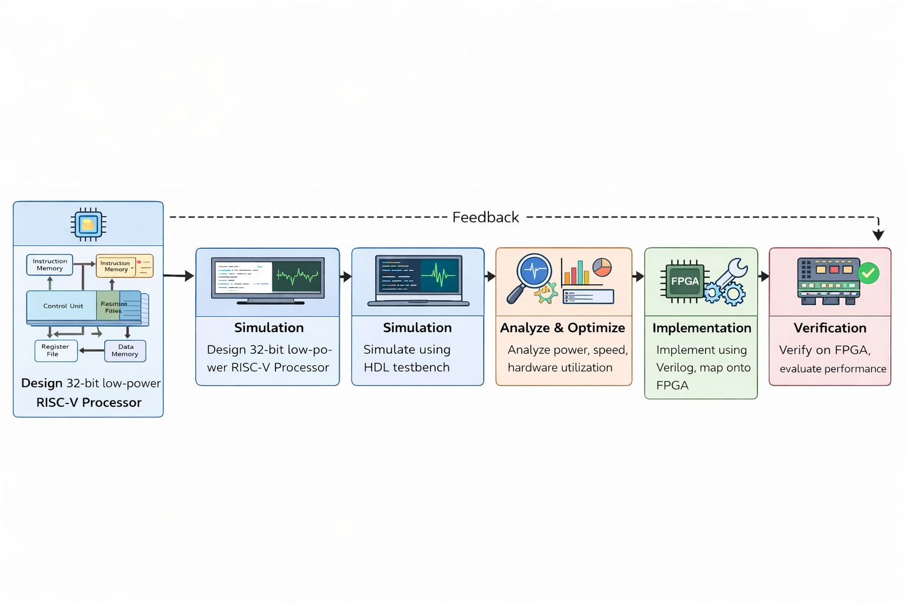
FLOW CHART

Slide 11
EXPECTED RESULTS
Reduced power consumption in biomedical signal processing systems.
Efficient hardware utilization with a compact processor design.
Improved performance using the RISC-V architecture.
Enhanced suitability for wearable and portable biomedical devices.
Mini project

Slide 12
ADVANTAGES
Low power consumption suitable for biomedical devices.
Efficient use of hardware resources with compact design.
High flexibility using RISC-V architecture.
Improved battery life for wearable and portable healthcare systems.

Slide 13
APPLICATIONS
Used in smart wearables that continuously monitor vital signals such as heart rate, ECG, and body temperature.
Suitable for devices implanted inside the body, such as pacemakers, where low power consumption is critical.
Used in portable medical equipment to process physiological signals like ECG or EEG efficiently.
Enables continuous monitoring of patient health data and transmission to doctors or healthcare centers.

Slide 14
REFERENCES
[1] V. P. Sharma, A. Kumar, M. F. Khan, M. Lokhande, and S. K. Vishvakarma, “Bio-RV: Low-power resource-efficient RISC-V processor for biomedical applications,” IEEE Trans. Biomed. Circuits Syst., 2025.
[2] K. Kurali and C. B. Fidan, “Implementation of FPGA based 32-bit RISC-V processor,” Microelectronics Journal, 2026.
[3] S. Yang, L. Shao, J. Huang, and W. Zou, “Design and implementation of low-power IoT RISC-V processor with hybrid encryption accelerator,” Electronics, vol. 12, no. 20, p. 4222, 2023.
[4] S. K. Narla, V. Yamsani, R. K. Gurrala, K. Jamal, and C. U. Kumari, “RISC-V processor design: RTL to GDSII implementation using EDA tools,” in Proc. Int. Conf. Smart & Sustainable Technology (INCSSIT), 2025.
[5] K. Teyene and H. Taconit, “Design and implementation of a low-power RISC-V processor core for energy-constrained edge devices,” J. Integr. VLSI, Embedded Comput. Technol., vol. 3, no. 1, pp. 7–14, 2026.
[6] J. Park et al., “Designing low-power RISC-V multicore processors with a shared lightweight floating point unit for IoT endnodes,” IEEE Trans. Circuits Syst. I, vol. 71, no. 9, pp. 4107–4120, 2024.

Slide 15
Road Map to the Project
PHASE 1-6th Sem
PHASE 2-6th Sem
PHASE 3 – 6th Sem
Topic Selection
Literature Review
Methodology Finalization
PHASE 1-7th Sem
PHASE 2 – 7th Sem
PHASE 3 – 7th Sem
Hardware & Software Development
Testing & Optimization
Final Implementation & Documentation

Slide 16
THANK YOU

